Slide 1

Credit and Debit Dashboard
Group 3
Pankaj Thakur
Sahil Mardhekar
Priyanka Madole

Slide 2
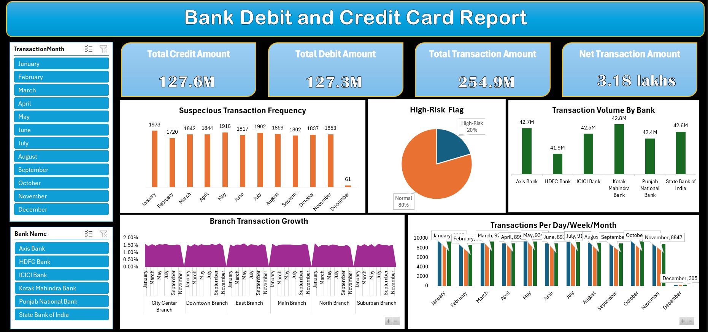
Excel

Slide 3
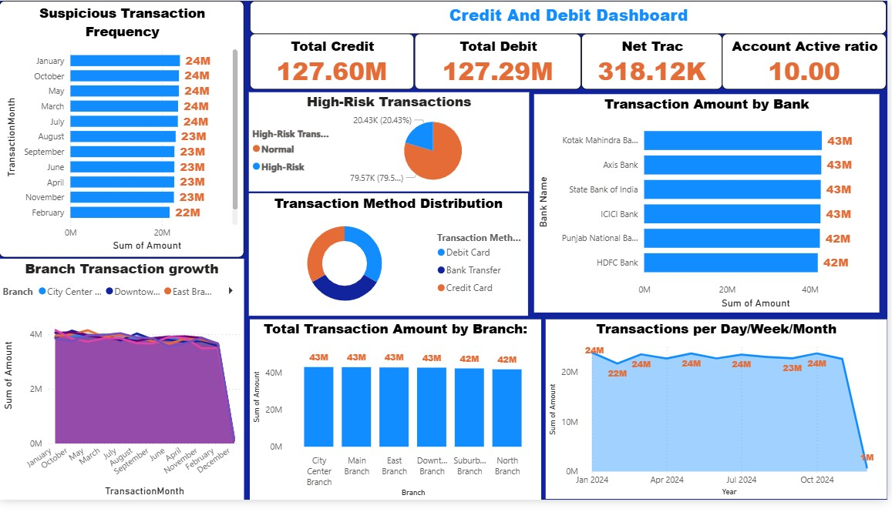
Power BI

Slide 4
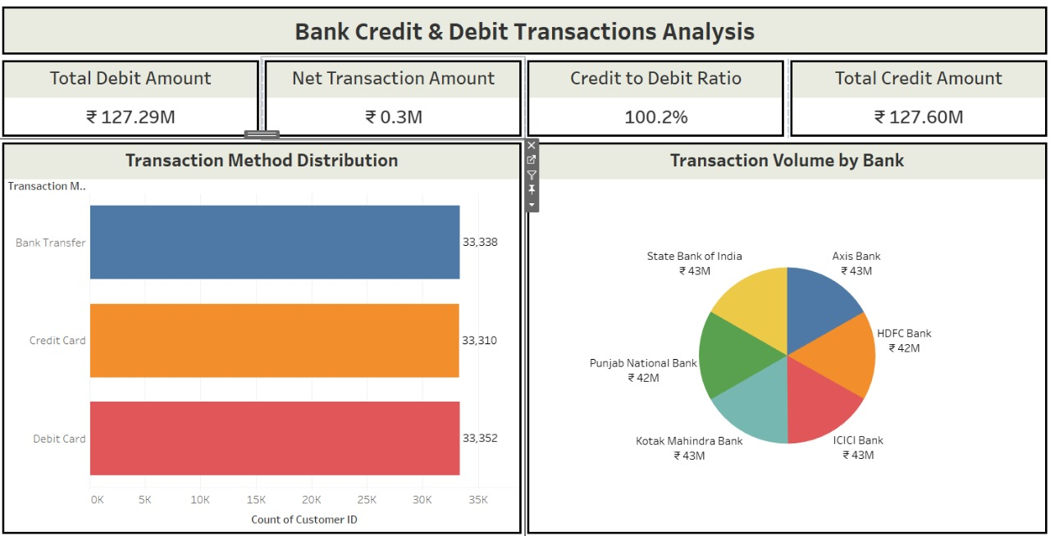
Tableau

Slide 5
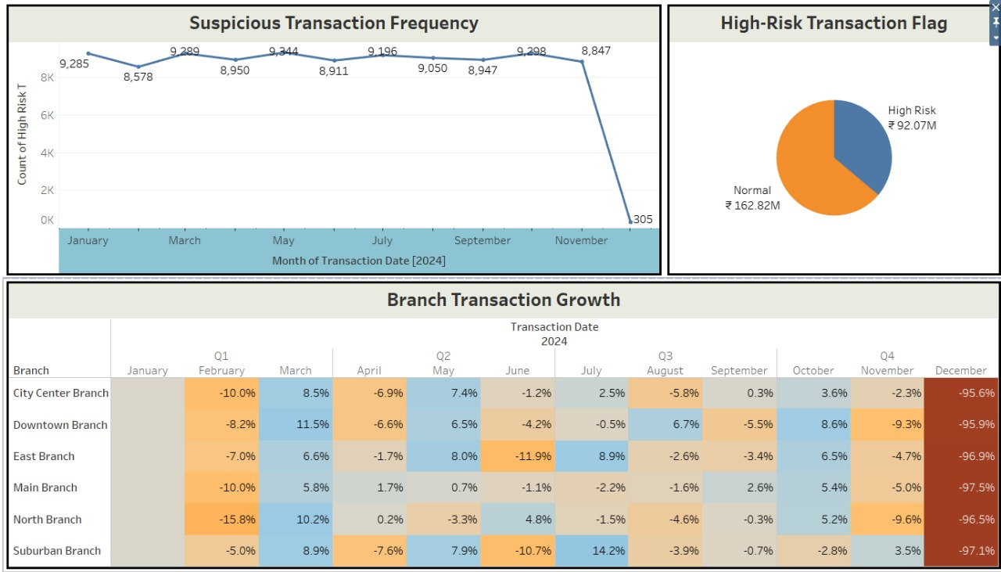

Slide 6

SQL
#1. Total Credit Amount
SELECT SUM(Amount) AS Total_Credit_AmountFROM credit_debitWHERE `Transaction Type` = 'Credit';
#2. Total Debit Amount
SELECT SUM(Amount) AS Total_Debit_AmountFROM credit_debitWHERE `Transaction Type` = 'Debit';
#3. Credit to Debit Ratio
SELECT SUM(CASE WHEN `Transaction Type` = 'Credit' THEN Amount ELSE 0 END) / SUM(CASE WHEN `Transaction Type` = 'Debit' THEN Amount ELSE 1 END) AS Credit_Debit_RatioFROM credit_debit;
#4. Net Transaction Amount
SELECT SUM(CASE WHEN `Transaction Type` = 'Credit' THEN Amount ELSE 0 END) - SUM(CASE WHEN `Transaction Type` = 'Debit' THEN Amount ELSE 0 END) AS Net_Transaction_AmountFROM credit_debit;
#5. Account Activity Ratio
SELECT `Account Number`, COUNT(*) / MAX(Balance) AS Account_Activity_RatioFROM credit_debitGROUP BY `Account Number`;

Slide 7
#6. Transactions per Day/Week/Month-- Per Day
SELECT DATE(`Transaction Date`) AS Day, COUNT(*) AS TransactionsFROM credit_debitGROUP BY DATE(`Transaction Date`);
Per Month……..
SELECT DATE_FORMAT(`Transaction Date`, '%Y-%m') AS Month, COUNT(*) AS TransactionsFROM credit_debitGROUP BY DATE_FORMAT(`Transaction Date`, '%Y-%m');
#7. Total Transaction Amount by Branch
SELECT Branch, SUM(Amount) AS Total_Transaction_AmountFROM credit_debitGROUP BY branch;
#8. Transaction Volume by Bank
SELECT `Bank Name`, SUM(Amount) AS Total_Transaction_AmountFROM credit_debitGROUP BY `Bank Name`;
#9. Transaction Method Distribution
SELECT `Transaction Method`, COUNT(*) AS Count, ROUND(COUNT(*) * 100.0 / (SELECT COUNT(*) FROM credit_debit), 2) AS PercentageFROM credit_debitGROUP BY `Transaction Method`;

Slide 8
#10. Branch Transaction Growth
SELECT Branch, SUM(CASE WHEN YEAR(`Transaction Date`) = 2024 THEN Amount ELSE 0 END) AS Amount_2024, SUM(CASE WHEN YEAR(`Transaction Date`) = 2025 THEN Amount ELSE 0 END) AS Amount_2025, ROUND(( SUM(CASE WHEN YEAR(`Transaction Date`) = 2025 THEN Amount ELSE 0 END) - SUM(CASE WHEN YEAR(`Transaction Date`) = 2024 THEN Amount ELSE 0 END) ) * 100.0 / NULLIF(SUM(CASE WHEN YEAR(`Transaction Date`) = 2024 THEN Amount ELSE 0 END), 0), 2) AS Growth_PercentFROM credit_debitGROUP BY Branch;
#11. High-Risk Transaction Flag
SELECT *, CASE WHEN Amount > 4000 THEN 'High-Risk' ELSE 'Normal' END AS Risk_FlagFROM credit_debit;
#12. Suspicious Transaction Frequency
SELECT COUNT(*) AS Suspicious_Transaction_CountFROM credit_debitWHERE Amount > 4000;

Slide 9
Challenges Faced & Solutions
Data Cleaning & Inconsistency ➤ Solution: Used Power Query to remove duplicates, fix null values, and apply conditional logic using Excel functions like IF and ISBLANK. ➤ Tool: Power Query Editor, Excel
High-Risk Transaction Classification ➤ Solution: Developed custom logic using DAX formulas and conditional flags (e.g., if transaction amount > threshold, then mark as high-risk). ➤ Tool: DAX, Power BI measures
Display in Lakhs/Millions Format ➤ Solution: Applied number formatting options in both Power BI and Excel using custom formats
(#,##,##0, #,##0,,) to improve readability. ➤ Tool: Power BI formatting, Excel Custom Number Format
Time-Based Analysis (Monthly/Weekly/Daily) ➤ Solution: Used a date table and built hierarchies (Year > Month > Week > Day) to allow drill-down in charts. ➤ Tool: Power BI Date Hierarchy, Calendar Table, DAX

Slide 10
Large Datasets Slowed Down Power BI ➤ Solution: Optimized data model by removing unnecessary columns, used summarization tables, and enabled query folding. ➤ Tool: Data Model Optimization, Aggregation Tables, Power Query
Dashboard Design and Layout ➤ Solution: Used consistent themes, fewer visuals, and grouped KPIs logically. Applied clean layout with proper spacing and titles. ➤ Tool: Power BI Layout Tips, Bookmark Navigation, Report Themes

Slide 11
Understanding Key Metrics
Complex metrics like Net Transaction or Active Ratio.
Created helper measures and tooltips for explanation.
Used cards and visuals with clear labels.
Thank You.

